Slide 1
GLOBAL TRADE & SUPPLY CHAIN
SUKH SHANTI INTERNATIONAL
Premium Polymers, PET Resins, Lubricant Additives, Base Oils & End-to-End Maritime Logistics with SGS Inspection Support.
GLOBAL FOOTPRINT
CERTIFIED QUALITY
RELIABLE LOGISTICS

Slide 2

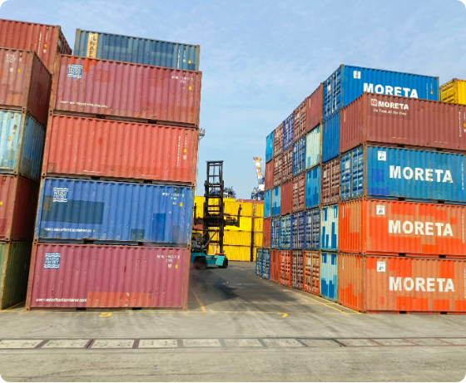
COMPANY PROFILE / 公司概况
Global Chemical & Polymer Supply Partner
Polymer & Resin Excellence
Supplying top-grade Polymers J0010, J0050, PET Resin WK82, and HDPE 5502 for global manufacturing needs.
Lubricants & Specialty Fluids
润滑油添加剂与基础油
Distributing comprehensive Lubricant Additives and premium Base Oils with strict technical compliance.
Seamless Shipping & SGS Inspection
全程海运物流与SGS质量检测
End-to-end container logistics backed by third-party SGS quality and quantity certification.

Slide 3

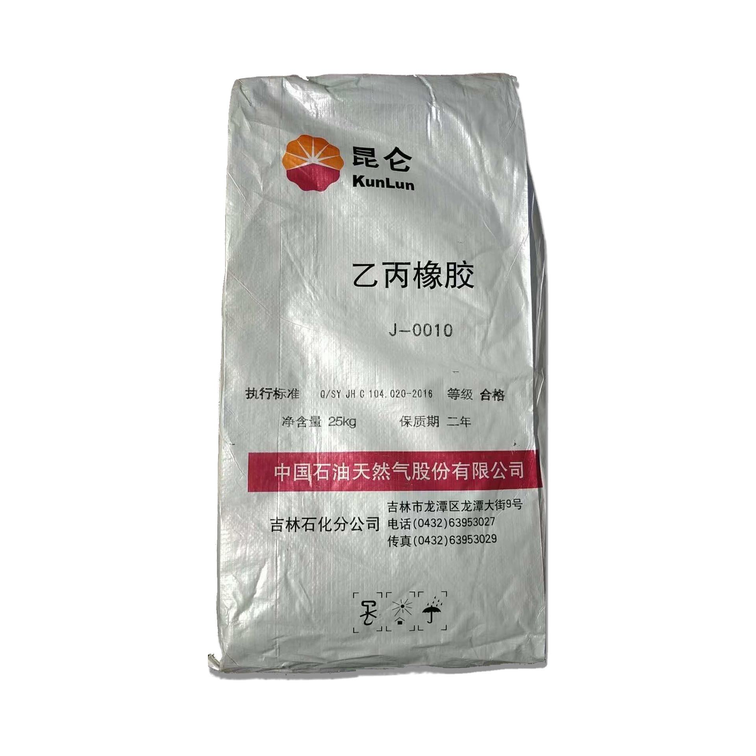
RAW MATERIALS / 原材料系列
Polymers: J0010 & J0050 Specifications
Polymer J0010 Grade / J0010
High Viscosity & Shear Stability
•
Melt Flow Index: Optimized for industrial compounding.
•
Applications: Viscosity index improver and plastic modifications.
•
Key Advantage: Outstanding thermal resistance and batch consistency.
Polymer J0050 Grade / J0050
•
Processing Ease: Superior dispersion and blending capability.
•
Target Uses: Automotive lubricant formulation & specialty polymers.
•
Packaging: Standard 25kg moisture-proof bags or palletized.

Slide 4
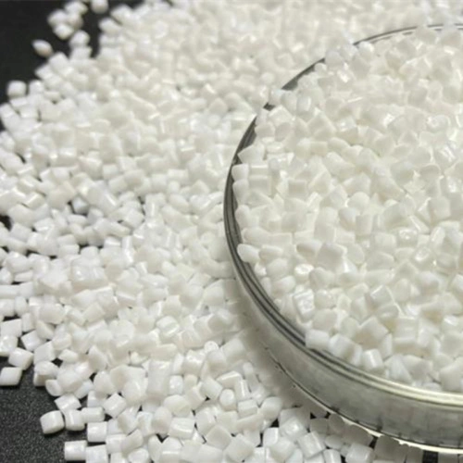
PET RESIN / PET
PET Resin Pellets: WK821 Grade
High Clarity & Intrinsic Viscosity / 高透明度与特性粘度
Intrinsic Viscosity (I.V.): 0.830 ± 0.015 dL/g
Designed specifically for edible oil bottles, beverage containers, and food packaging preforms requiring high mechanical strength.
≤ 1.0 ppm
250°C
Low Acetaldehyde (AA)
Melting Point
Key Applications / 主要应用领域
Edible oil bottles, water bottles, CSD containers, thermoforming sheets.

Slide 5
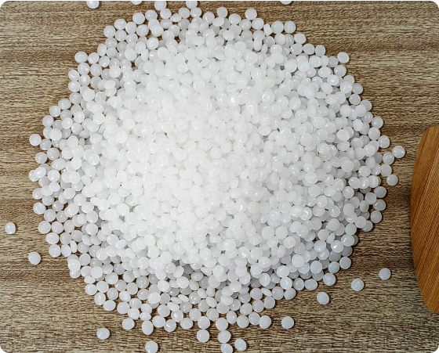
HIGH DENSITY POLYETHYLENE
HDPE 5502 Type Blow Molding Resin
Material Characteristics
Ethylene-hexene copolymer designed for small-to-medium blow-molded containers. Features high rigidity, environmental stress crack resistance (ESCR), and impact strength.
MFR (190°C/2.16kg)
Density
0.35 g/10min
0.954 g/cm³
Primary End Uses
Household chemical bottles, cosmetic containers, detergent bottles, and industrial lubricant cans up to 5 Liters.

Slide 6

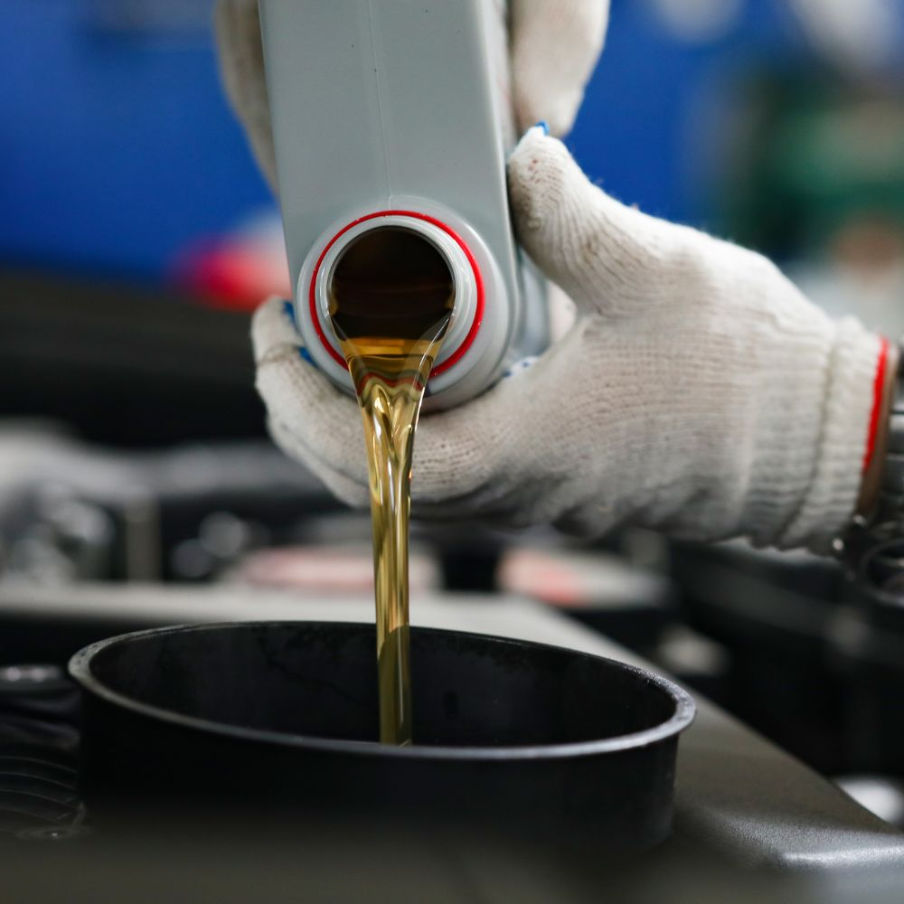
ADDITIVE PACKAGES
Comprehensive Lubricant Additives
Heavy-Duty Diesel Packages
API CK-4 / CI-4 / CH-4
RF6088, RF6069, RF6078 Series)
High soot dispersancy, piston cleanliness, and oxidation resistance.
Gasoline Engine Packages
API SP / SN / SL
(ACEA C3/C2, API SP/SL Series)
Inhibits sludge formation, prevents LSPI, and ensures wear protection.
Industrial & Hydraulic Fluids
Gear & Hydraulic
(Zinc & Ashless Types)
Superior thermal stability, anti-wear, and anti-foam performance.

Slide 7
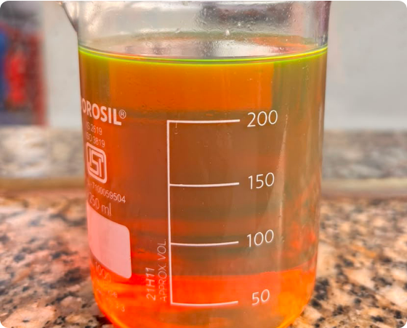
PETROCHEMICALS
Premium Base Oils Supply
Group I / II / III
API Group I & II Base Oils
High saturates and excellent solvency, ideal for formulating industrial gear oils, heavy-duty engine oils, and general lubricants.
API Group III & Synthetic Stocks
Severe hydrocracked base stocks with high Viscosity Index (VI), low volatility, and superb oxidation stability for top-tier passenger car formulations.
Bulk Logistics Solutions
Supplied via Flexitanks, ISO Tanks, and 200L Steel Drums with guaranteed purity.

Slide 8


LOGISTICS & FREIGHT
Global Maritime Logistics & Freight Management
Containerized Shipping (FCL / LCL)
Full Container Load operations in 20ft / 40ft dry containers and specialized Flexitank containers for liquid bulk cargo.
Ocean Freight Navigation
Partnered with major global vessel operators ensuring competitive freight rates, predictable transit times, and door-to-door tracking.
Port Handling & Warehousing
Secure port staging, customized palletization, stretch wrapping, and export customs clearance.

Slide 9
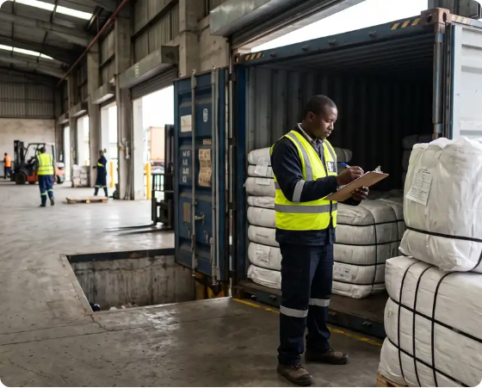
QUALITY ASSURANCE
Strict SGS Inspection & Quality Testing
Independent SGS Pre-Shipment Inspection
Every shipment undergoes rigorous quantity verification, packaging integrity inspection, and container sealing supervision by SGS inspectors.
Chemical Specification Verification
Comprehensive laboratory testing for Intrinsic Viscosity (I.V.), Melt Flow Index, Total Base Number (TBN), and density specifications prior to issue of Certificate of Analysis (COA).
Risk Elimination & Buyer Protection
Guarantees that buyers receive exact product grades conforming 100% to contractual standards.

Slide 10
PORTFOLIO MATRIX
Complete Product Summary & Specifications
Sukh Shanti International
Product Product Line / 产品类别 | Grade & Specs / 规格型号 | Key Characteristics / 核心特性 | Primary Applications / 主要应用
Polymers | J0010 & J0050 | High thermal stability, excelente shear resistance. | Lubricant modifiers, industrial polymers.
PET Resin | WK821 Grade | IV 0.830, low AA (≤1.0ppm), superior clarity. | Edible oil bottles, beverage preforms.
HDPE Resin | 5502 Type | MFR 0.35 g/10min, high ESCR & stiffness. | Blow molded bottles & containers ≤ 5L.
Lubricant Additives | CK-4 / SP / Industrial | Balanced detergency, dispersancy, anti-wear. | Automotive & industrial oil blending.
Base Oils | Group I / II / III | High VI, low volatility, pure chemical composition. | Base stock for all lubricant grades.

Slide 11
PROCESS & LOGISTICS
Our End-to-End Fulfillment Process
1
2
3
4
5
Sourcing & Contract
SGS Inspection
Container Loading
Ocean Transit
Destination Delivery
Factory direct specification alignment.
COA generation & physical verification.
Palletized or Flexitank vessel loading.
Reliable maritime shipping lines.
Smooth customs clearing & un-loading.

Slide 12
PARTNER WITH US
SUKH SHANTI INTERNATIONAL
Global Shipping & Trade Logistics
SGS Certified Products
Contact Us for Inquiries & Quotes

